Slide 1
H0201280 Talk-to-Code: Coding by Dictation
By: Lam Zhen Zong Nicholas
Project Supervisor: Assoc Prof. Ooi Wei Tsang

Slide 2
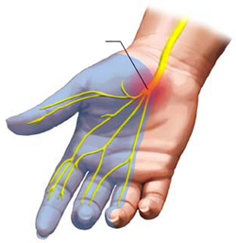
Objectives of the Project
Help people suffering from Carpal Tunnel Syndrome (CTS) to write code. [CTS is also known as Repetitive Strain Injury]
CTS – medical condition affecting median nerves of the hand
Programmers type code repeatedly for long hours.
Assist programmers to write code hands-free
This project allows users to write a program by voice
Notes:
CTS-medical : CTS causes pain to the user.
Programmers-type : This affects programmers the most, as they are required to perform repetitive tasks like typing code for a long period of time.
Assist-programmers: Programmers not suffering from CTS will not contract it and programmers suffering from CTS are able to write code once again.
[Credit] Dr. Vikas Sharma MD [https://www.drhomeo.com/orthopedic-problems/homeopathic-remedies-for-carpal-tunnel-syndrome/]

Slide 3
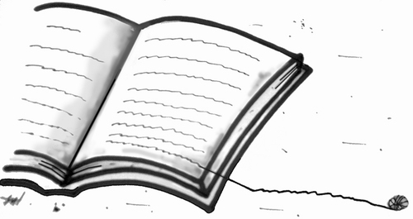
Literature Review
Two Approaches
Command based approach
Natural language based approach
Notes:
[Credit] Monica Zanet [https://www.toonpool.com/cartoons/Literature_115543]

Slide 4

Command Based Approach
VoiceCode.io (example)
By Ben Meyers, programmer suffering from CTS
Program where user use voice to control computer in real-time.
Emails, switch between applications, etc.
User’s speech in form of a command
E.g. “Doon twenty-one” → press down-arrow key 21 times.

Slide 5
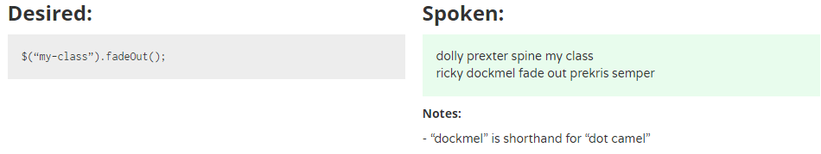
Command Based Approach
VoiceCode.io (example)
Example of spoken command for jQuery:

Slide 6
Command Based Approach
VoiceCode.io (example)
Strength: used for any programming language (because low-level building blocks used)
Limitations:
Steep learning curve (non-natural language words)
Lower productivity levels
Learning points:
Need more natural English words
Notes:
Steep learning curve – hard to remember , take lots of time to issue correct command for code.
Low productivity – additional time to learn new language or look at reference sheet. → time better spent doing something more productive
Learning point – easier to remember and smoothen the learning curve.

Slide 7
Natural language based approach
Spoken Java (example)
By Andrew Begel and Susan L. Graham
Their motivation: help CTS programmers
Program where user use voice to code in natural way instead of typing.
They found that existing solutions not natural enough for programmers.

Slide 8
Natural language based approach
Begel’s research: Challenges with voice-based programming
Speech is ambiguous in nature
Homophones (same pronunciation, different spellings)
Sentences can sound like asking question or making statement
Stop words (“uh”, “um”, “erm”)
Notes:
According to Begel’s research before he develop the Spoken Java program, he found …
Example for homophones ( I vs eye, to vs two)
Difficult to interpret by computers.

Slide 9
Natural language based approach
Begel’s research: Challenges with voice-based programming
Programming languages and tools were not meant to be ambiguous
They are designed to be read by computers (not humans)
Required to be precise, contain all punctuations
Contrary to the nature of speech (ambiguous)
Notes:
Required to be precise – so that compiling and running of the program code can be very efficient and feasible in implementation.
Therefore, difficult to translate speech into programming languages as speech is ambiguous while programming languages cannot afford to be ambiguous.

Slide 10
Natural language based approach
Begel’s research: Challenges with voice-based programming
Speech tools are not suitable for programming tasks
Speech recognizers designed for creating / editing text documents
Training of Speech recognizers done to support word processing tasks.
Word processing tasks ≠ Programming tasks
Notes:
Programming tasks such as create, edit, navigate through programs.
Thus, speech tools not suited for programming.

Slide 11
Natural language based approach
Begel’s research: Challenges with voice-based programming
Using voice for software development is something new for programmers
Programmers very used to keyboard
Difficult to adapt to switching (time and effort needed)

Slide 12
Natural language based approach
Begel’s experiment: How programmers verbalize code
Spoken words are hard to write down
Homophones (same word recognized differently by Speech Recognizer)
Capitalization not explicitly verbalized.
Ambiguity of spaces between words. ( “drop stack process” vs “dropStackProcess” )
Notes:
Conduct an experiment with 10 expert programmers to read java code. Points found out…
Capitalization not verbalized – problems as many programming languages are case sensitive.

Slide 13
Natural language based approach
Begel’s experiment: How programmers verbalize code
Structural ambiguities
User tends to omit punctuation when spoken.
Dot in object.stack
Parentheses in method call like “e.printStackTrace()”
Punctuations important to precisely mark our different program structures.

Slide 14
Natural language based approach
Begel’s experiment: How programmers verbalize code
Abstraction by programmers
Natural and common to speak in higher-level code
Example: “Set all the fields of array to null”
This is worth looking at in the future as it can improve productivity (1 phrase → many lines of code)
Notes:
Natural and common for programmers to speak in high level code instead of low level constructs, this is in spite of them being asked to verbalize program code and not paraphrase visible patterns.
Example – instead of verbalizing it explicitly. (array index 0 equal null, array index 1 equal null and so on)
[Q&A only] Future – because high level code is quite ambiguous for computers to translate precisely.

Slide 15
Natural language based approach
Begel’s experiment: How programmers verbalize code
Disambiguation
English native speakers use prosody for disambiguation.
Example: “array sub i plus plus” for array[i]++ or array[i++]
Non-native speakers use their own native language’s prosody
Notes:
[e.g.] English native speakers utilize pause to indicate grouping of terms in that expression to differentiate above cases. Array sub I <pause> plus plus
Array sub <pause> I plus plus
Non-native – use their own native language prosody when speaking English → change meaning of word

Slide 16
Natural language based approach
Spoken Java (example)
Using their experiment results → design and create Spoken Java
Match closely to how programmers verbalize code
Made improvements to their program to address issues from study.

Slide 17
Natural language based approach
Spoken Java (example)
Has an analysis framework – Harmonia
Analyzes texts translated by Speech recognizer
Harmonia handles homophones, miscapitalized words and concatenated words by using contextual information.
Notes:
Harmonia handles – by using contextual info to perform disambiguation and choose the proper interpretations to translate Spoken Java into Java code.
[Note only] Spoken Java is also defined by a lexical specification which allows for different ways of verbalizations to match the same construct.

Slide 18
Natural language based approach
Limitations in Begel’s study
Lack of feedback
Program spoken in linear fashion
Different programming styles
Coding does not involve reading from script
Notes:
Lack of feedback – programmers receive no feedback of their current state when verbalizing the code → know nothing about program correctness. → prevent them from understanding how programmers would verbally edit code.
Linear fashion – this is unlike how programmers will write code → where they might go front and back when writing code.
Diff programming styles – some prefer modular programming, some prefer planning interface first before writing code. All these styles require speech system and analysis of partial code, which is unsupported by Spoken Java.
Reading from script – coding involves writing code on the fly. This action of spontaneous voice-based coding can show us how programmers will edit or code in a non-linear manner. Begel study doesn’t do this and we do not know what kind of error and ambiguities will surface.

Slide 19
Natural language based approach
Limitations in Begel’s study
Learning points
Important to eliminate ambiguities
Importance of feedback
How programmers verbalize code
Notes:
Eliminate ambiguity – programming language is precise, and we have to restrict what the user can say to achieve this
Importance of feedback – so that programmer will know current progress and correctness of program
Verbalize code – omit punctuations and ambiguity , so we need to have a more structured language to handle these cases

Slide 20
Project Overview
End-to-end program which converts user’s voice into program code.
Using structured language
Notes:
Structured language – Ambiguities like : different programmers might have more than one way of saying same code
Please refer to given handout for structured language

Slide 21
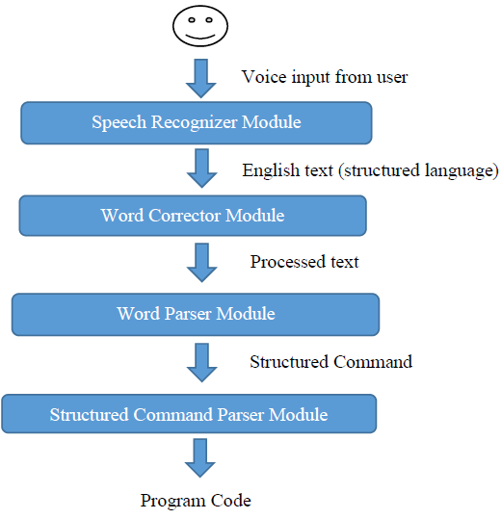
System Architecture

Slide 22
declare float money equal three point two and declare
declare float money equal three point two end declare
#create float #variable money #value 3.2 #dec_end;;
float money = 3.2;

Slide 23
Speech Recognizer module
Converts voice input into English text.
Using python Speech Recognition library
Supports several APIs
Experiment on the APIs

Slide 24
Speech Recognizer module
Experiment with basket of keywords:
Keywords | Google Speech Recognition | Google Cloud Speech API | Microsoft Bing Voice Recognition | Total
Equal | 7 / 10 | 9 / 10 | 6 / 10 | 22 / 30
If Then Else | 5 / 10 | 5 / 10 | 5 / 10 | 15 / 30
End If | 0 / 10 | 5 / 10 | 0 / 10 | 5 / 30
Declare integer | 5 / 10 | 7 / 10 | 0 / 10 | 12 / 30
Size | 6 / 10 | 9 / 10 | 8 / 10 | 23 / 30
Index | 9 / 10 | 10 / 10 | 10 / 10 | 29 / 30
Create Function | 4 / 10 | 9 / 10 | 6 / 10 | 19 / 30
Return Type | 1 / 10 | 8 / 10 | 2 / 10 | 11 / 30
Parameter | 3 / 10 | 9 / 10 | 1 / 10 | 13 / 30
Call | 5 / 10 | 5 / 10 | 10 / 10 | 20 / 30
For | 0 / 10 | 0 / 10 | 0 / 10 | 0 / 30
Plus plus | 5 / 10 | 6 / 10 | 7 / 10 | 18 / 30
While | 0 / 10 | 4 / 10 | 0 / 10 | 4 / 30
Switch case end switch | 0 / 10 | 0 / 10 | 0 / 10 | 0 / 30
Dot | 2 / 10 | 4 / 10 | 0 / 10 | 6 / 30
Notes:
After coming up with the first draft of my own structured language, I have picked out some of the keywords and conducted an experiment with 10 participants.
They were asked to record their voice into an audio file which consists of the keywords, and then these audio files passed through my speech recognizer.
From the figure above, it can be noted that Google Cloud Speech API consistently performs better than the other two in most of the cases of keywords.
The difference between Google Speech Recognition and Google Cloud Speech API lies within the fact that the latter allows for a list of preferred phrases to be passed into the recognition process, which greatly enhances the accuracy of the speech recognition.
On the other hand, Microsoft Bing Voice Recognition seem to be only accurate for a few keywords and is largely inaccurate for most of the keywords involved.

Slide 25
Speech Recognizer module
Experiment with script for sample program:
 | Google Speech Recognition | Google Cloud Speech API | Microsoft Bing Voice Recognition | Total
Total | 389 / 640 | 423 / 640 | 247 / 640 | 1059 / 1920
Notes:
Previous experiment focuses more on keywords as a starting point for our analysis.
However, the actual recognition process would require user to speak in complete sentences. “declare integer count equal zero” and NOT “declare integer”
So I conducted another experiment, in which a script for finding maximum number in integer array was written using my structured language, for the same 10 participants
The numbers above confirms Google Cloud Speech API produces the most accurate results over the other two APIs.
I have also observed from the raw data of the results that Microsoft Bing Voice Recognition is more suitable for recognizing proper complete English sentences than user-defined structured language.
As such, I have decided on the use of Google Cloud Speech API for my speech recognizer module.

Slide 26
Word Corrector module
Process input English text into processed English text.
Because Speech Recognition module is not perfect. (some words misinterpreted)
Phase 1: Correct commonly misinterpreted words
Phase 2: Correct variable names using contextual information.
Notes:
Contextual info about previously declared variables in variable or function declaration statements.

Slide 27
Word Corrector module
Phase 1
Utilize raw data results from earlier experiments to correct common misinterpretations
Example: End constructs often misinterpreted.
“End function” misinterpreted as “and function”
Notes:
Misinterpretations from speech recognizer.
Example – attempt to correct “and” into “end” if the word “and” appended with the following word will form a valid end construct.
Word Corrector module mainly targets the correction of keywords

Slide 28
Word Corrector module
Phase 2
Use contextual information about previously declared variables to do correction.
Variable | makes
Find most similar
Declared Variables
number
length
max
Notes:
I will illustrate this correction with a simple example.

Slide 29

Word Corrector module
Phase 2
Use contextual information about previously declared variables to do correction.
Variable | makes
Declared Variables
number
length
max
Encode(“number”)
Encode(“length”)
Encode(“makes”)
Encode(“max”)
Phonetic Encoding with American Soundex
Notes:
This is done with the aid of jellyfish python library, which does approximate and phonetic matching of strings.
First, we will convert all the words into their phonetic encodings using American Soundex.

Slide 30
Word Corrector module
Phase 2
Use contextual information about previously declared variables to do correction.
max
Declared Variables
number
length
max
Variable | makes
0.0
Encode(“number”)
0.5
Encode(“length”)
Encode(“makes”)
Encode(“max”)
0.85
Compare with Jaro-Winkler Distance
Notes:
Then we will compare the resulting phonetic encodings with Jaro-Winkler Distance
to get a similarity index between each pair of words.
As the similarity index between “makes” and “max” is 0.85, which is the highest, “makes” will be replaced by “max”
[Q&A only] Jaro-Winkler distance: string metric for measuring the edit distance between two sequences. The Jaro distance between two words is the minimum number of single-character transpositions required to change one word into the other.]

Slide 31
Word Corrector module
About jellyfish python library
Many ways of Phonetic encoding
American Soundex
Metaphone
NYSIIS
Many ways of string comparisons
Levenshtein Distance
Damerau-Levenshtein Distance
Hamming Distance
Jaro Distance
Jaro-Winkler Distance
Notes:
As the jellyfish python library provides more than just one way of doing phonetic encoding and string comparisons, there is a need to test which pair of algorithms deliver better results.
It is preferable to have differentiable similarity indices between different pair of words (i.e. no ties in similarity index). After much testing, I have found that American Soundex and Jaro-Winkler Distance are the best fit for this purpose.

Slide 32
Word Corrector module
Limitations
Heuristic to find closest matching pair of words
Sometimes it can be difficult to tell which words are of closer match
Example: Is “wood” closer to “book”, “loot” or “could”
Notes:
The way which we use to find the closest matching pair of words is actually a heuristic and not an algorithm. This is due to the fact that it is difficult to truly tell which word is closer to a particular target word.
For instance, if we have already declared the variables “book”, “loot”, “could” and we need to correct the word “wood”, which of these 3 variables would we deem as closest matching to the word “wood”. [FYI: program says loot]
However, this heuristic is good enough for the purposes of this program in most instances, after testing the program with our script for the sample program from our earlier experiment.

Slide 33
Word Parser module
Converts processed text into structured command
Using python pyparsing library
Allows parsing with user-defined grammar rules
Allows easy editing of structured language
Context free grammar
Notes:
user-defined grammar rules - our structured language in this case
allows easy editing of the structured language – definitely easier to change when necessary as compared to a hardcoded algorithm.
Context free grammar - We have also introduced the concept of context free grammar in defining our structured language’s grammar rules, after realizing that the initial set of language defined is not really properly designed and errors are not properly detected. With context free grammar, the grammar rules are now more well-defined and that new constructs or edits can be done more easily to the parser now.
[Q&A] CFG - a set of production rules that describe all possible strings in a given formal language. Production rules are simple replacements. In context-free grammars, all rules are one-to-one, one-to-many, or one-to-none. These rules can be applied regardless of context. The left-hand side of the production rule is always a non-terminal symbol. This means that the symbol does not appear in the resulting formal language.

Slide 34
Word Parser module
Example: Function Declaration construct
function_declaration_line = keyword_create_function + variable_name + Optional(keyword_with) + keyword_return_type + variable_type + ZeroOrMore(parameter_statement.setResultsName("params", True)) + keyword_begin + ZeroOrMore(statement.setResultsName("stmts", True)) + keyword_end_function
keyword_begin_function
Notes:
Let us look at an example of the function declaration construct using pyparsing and using context free grammar for our structured language.
Here we can see that this structured can be easily changed and it is properly defined from the start keyword to the ending keyword.
Any part of the construct can be replaced by some other keyword, and we can also add in extra keywords or remove some terms in the construct should the need arises.
Animation – For example, lets say we want to replace the keyword from create function to begin function, we just have to replace it this way.

Slide 35
Structured Command Parser module
Converts structured command into program code
Wrapper module
Runs the Java program from previous project
The program able to construct a C program with its Abstracted Syntactical structure.
Notes:
Previous project – titled Talk-to-Code: From Structured Command to Source Code.
The program from previous project is able to convert the structured command into Abstracted Syntactical structure, which then constructs a compilable and runnable C program.
This module completes our end-to-end program and generates C program code.
[FYI] Abstract Syntax Tree - is a tree representation of the abstract syntactic structure of source code written in a programming language. Each node of the tree denotes a construct occurring in the source code.

Slide 36
Product Demo
Notes:
Maybe show a simple demo then let the evaluator try the demo ?
declare integer first equal one end declare
Declare integer second equal two end declare
Declare integer temporary equal first end declare
First equal second end equal
Second equal temporary end equal

Slide 37
Plans for next semester
Improving the Structured Language
A little bit difficult to remember
While retaining unambiguous domain
Use keywords recognized more easily
Notes:
Point 1 – Continue to redefine and edit the structured language as the current structured language might be a little bit difficult to remember by heart and still lack some natural English language aspects.
Point 2 – This must be done while retaining the unambiguous domain of the language so that the translation to program code is not ambiguous.
Point 3 - There will also be attempts to improve the structured language to use keywords which can be more easily recognized by the Speech Recognition module to make the recognition process more accurate. Example: “begin if” can be recognized while “if” is omitted most of the time.
[Q&A] natural English language aspects – spoken in a more natural English manner.

Slide 38
Plans for next semester
Adding more constructs to the Structured Language
Switch statement (switch – case construct)
Logical “and”, logical “or” for comparison statements
Shorthand assignment operators (i.e. += , *= )
Allowing symbols like percentage (%), dollar ($), ampersand (&)
Many more…
Notes:
The current structured language does not contain every programming construct available, and is restricted to only a limited set of constructs. The plan for the following semester would be to introduce more constructs to the program. Some of the constructs which were planned to be added includes…
[See points in slides]
The sets of constructs to be added are not exhaustive. There will be many more other constructs which could be added as well, with the more commonly used constructs taking precedence in the order of my implementation in future.

Slide 39
Plans for next semester
Improving Word Corrector module
Phase 1 correction currently uses hardcoded algorithm
One possible way: Use word similarity heuristic in Word Corrector module phase 2
Look at the plausibility of such method and find alternative methods if necessary
Notes:
The Word Corrector module’s phase one currently uses a hardcoded algorithm to correct common errors, and this will change in the next semester. A hardcoded algorithm is not robust enough and is not easy for us to edit or make changes.
One possible way would be to use the word similarity heuristic in Word Corrector module’s phase two to perform the correction.
We could possibly use a list of keywords and check if the recognized word from the Speech Recognition module has a close similarity to any of the keywords in the list and perform the correction.
In the next semester, I will look at the plausibility of employing such a method to perform the correction and also investigate and research for more alternative methods to improve the correction, to check if there is any better way of doing the correction.

Slide 40
Plans for next semester
Improving overall program
Develop a GUI
Keeps reading voice input
Program Code | History
int main () { int a; } | create function main return type integer begin declare integer a end declare
Feedback: Unrecognized language: “E clair integer b and declare”
You can start speaking the next line now …
Undo
Export
Cheatsheet
Notes:
Explain GUI
Keeps reading voice input – the final program will keep reading voice input and the user doesn’t have to keep typing to accept or reject what the program recognizes. This program will accept whatever the user says unless the user says undo or click on undo

Slide 41
End
Thank you

